Slide 1
English lesson
3rd grade
07.04.2020
Mrs. dineva

Slide 2
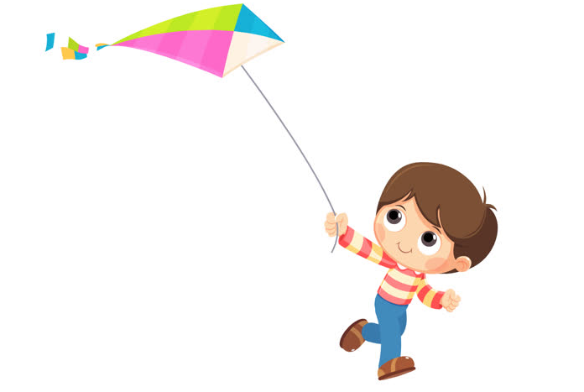
Read and choose
1. It’s spring. Are you flying your kite?
a) Yes, I am. b) No, I am not.

Slide 3
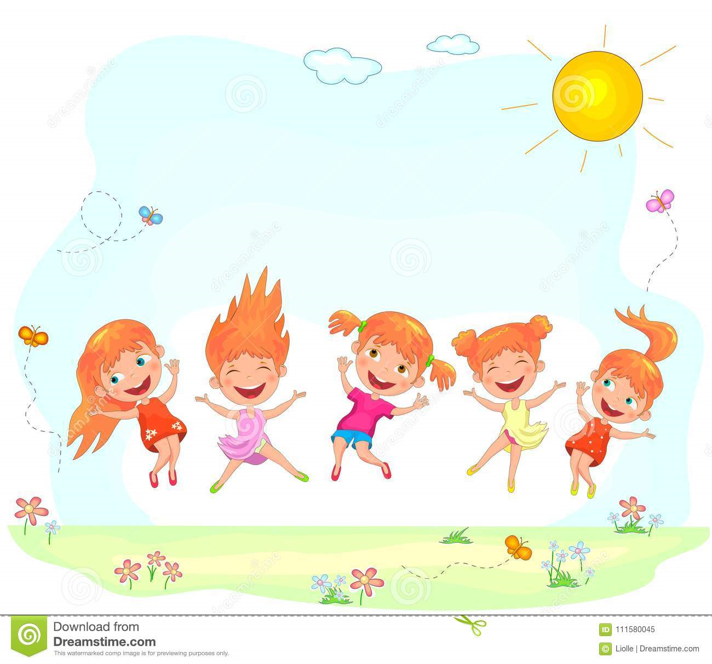
Read and choose
It’s summer. Are you wearing your coat?
a) Yes, I am. b) No, I’m not.

Slide 4
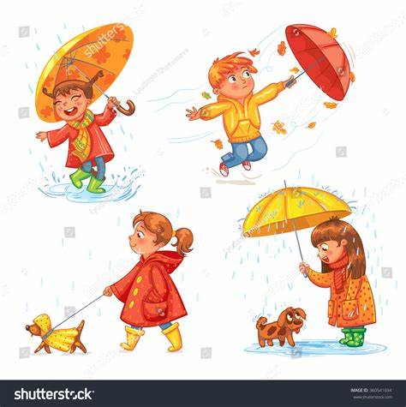
Read and choose
It’s autumn. Are you swimming?
a) Yes, I am. b) No, I’m not.

Slide 5
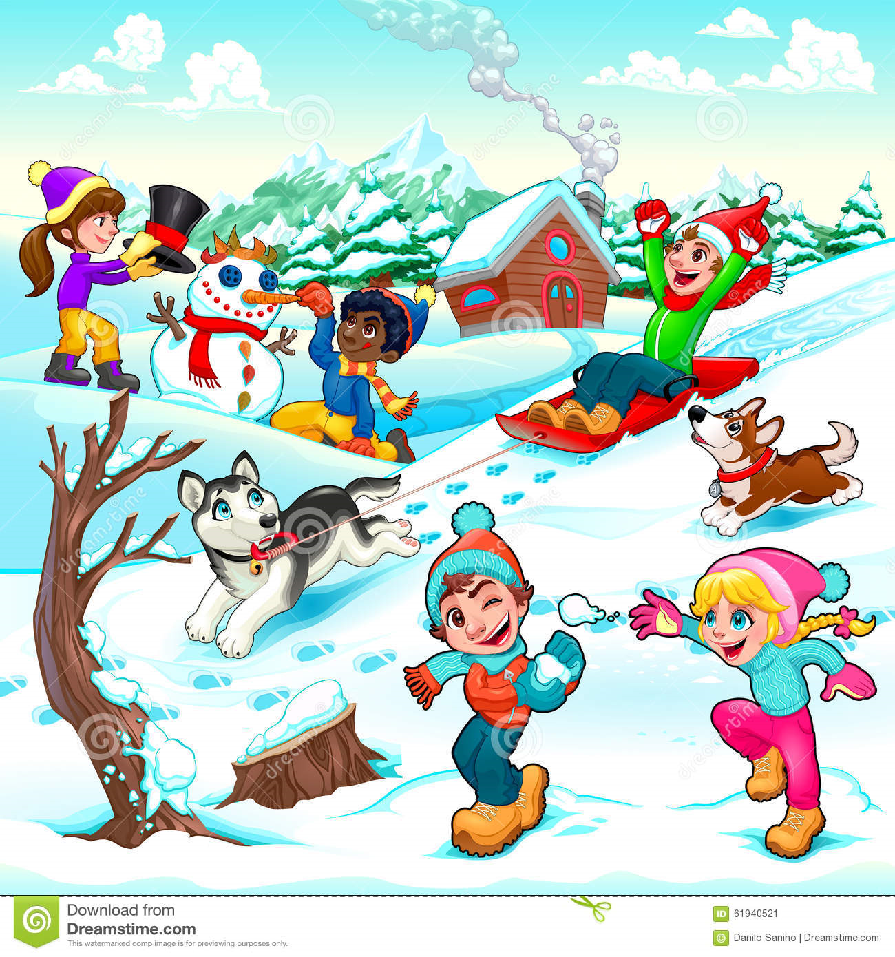
Read and choose
It’s winter. Are you making a snowman?
a) Yes, I am. b) No, I’m not.

Slide 6
Dear Diary
diary - дневник
tidy my room – подреждам си стаята
sleep - спя
watch TV – гледам телевизия
eat an ice cream – ям сладолед
drink milk – пия мляко
listen to music – слушам музика
pick flowers – бера цветя

Slide 7

diary - дневник

Slide 8
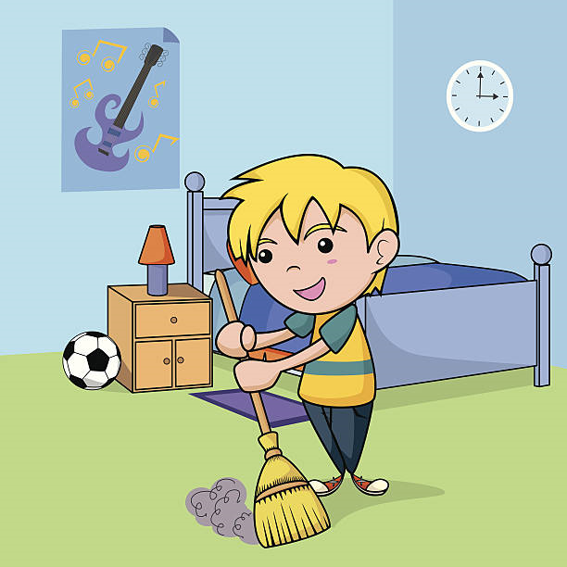
tidy my room – подреждам си стаята

Slide 9
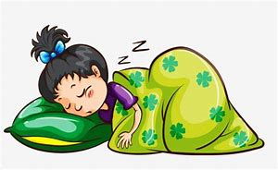
sleep - спя

Slide 10
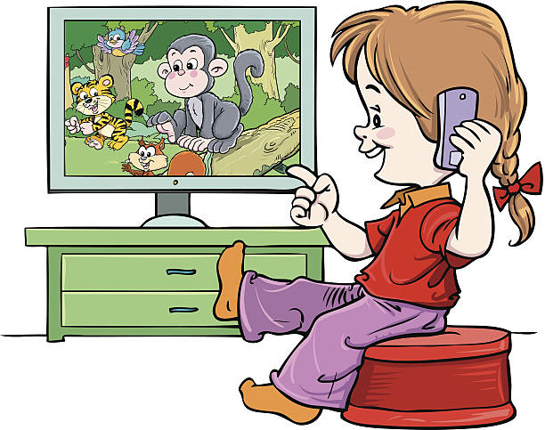
watch TV – гледам телевизия

Slide 11
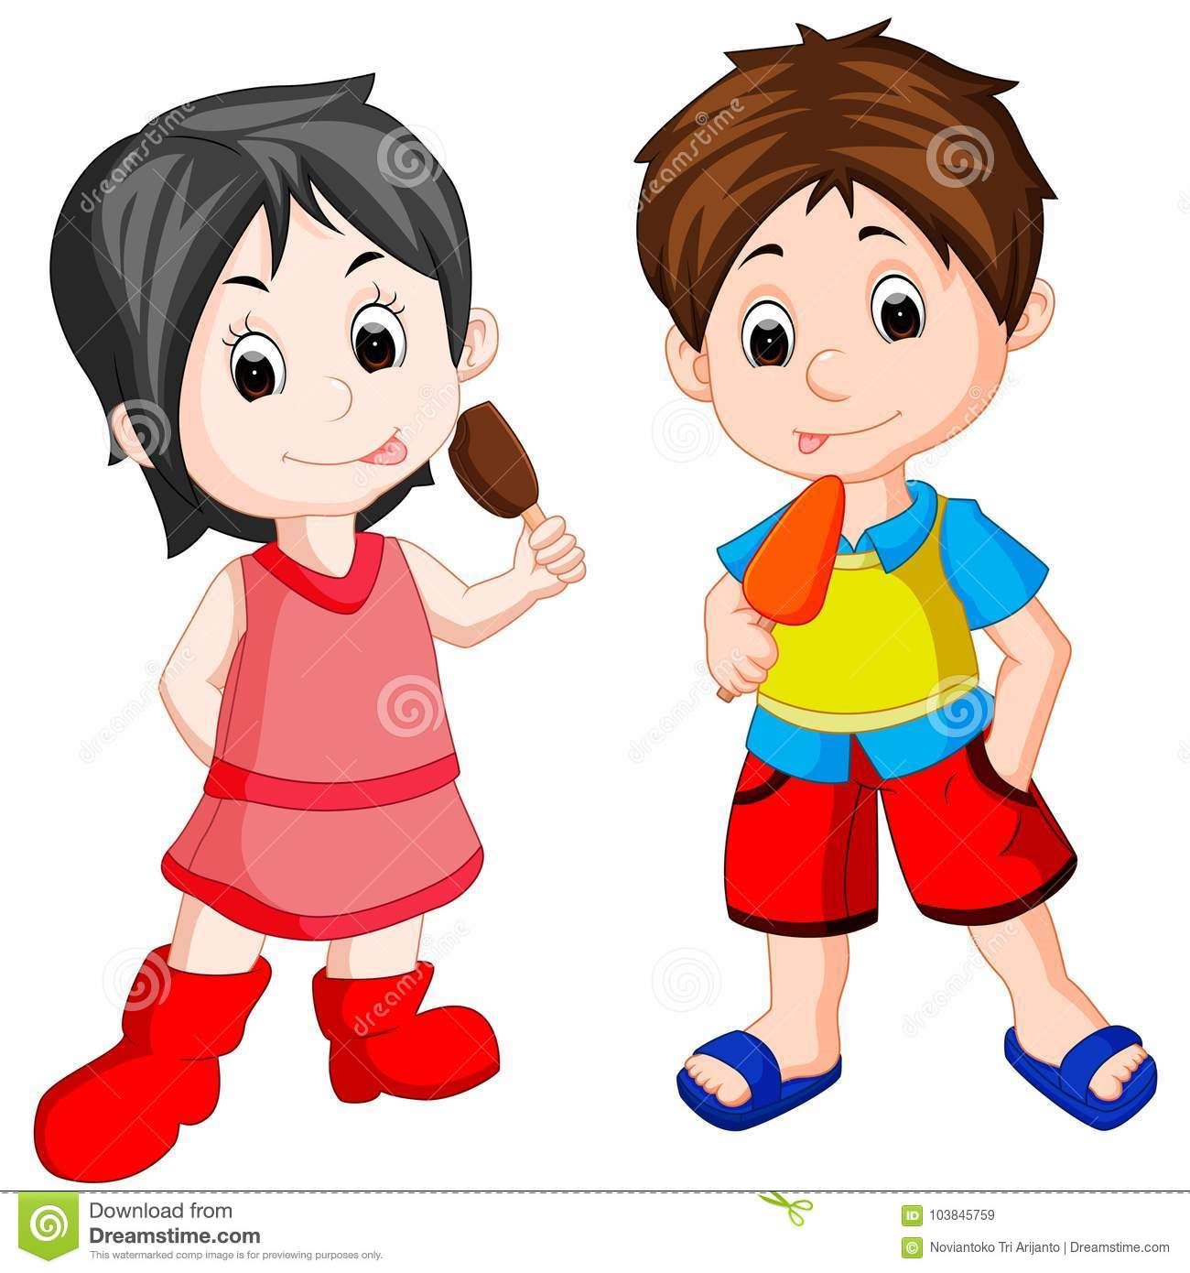
eat an ice cream – ям сладолед

Slide 12
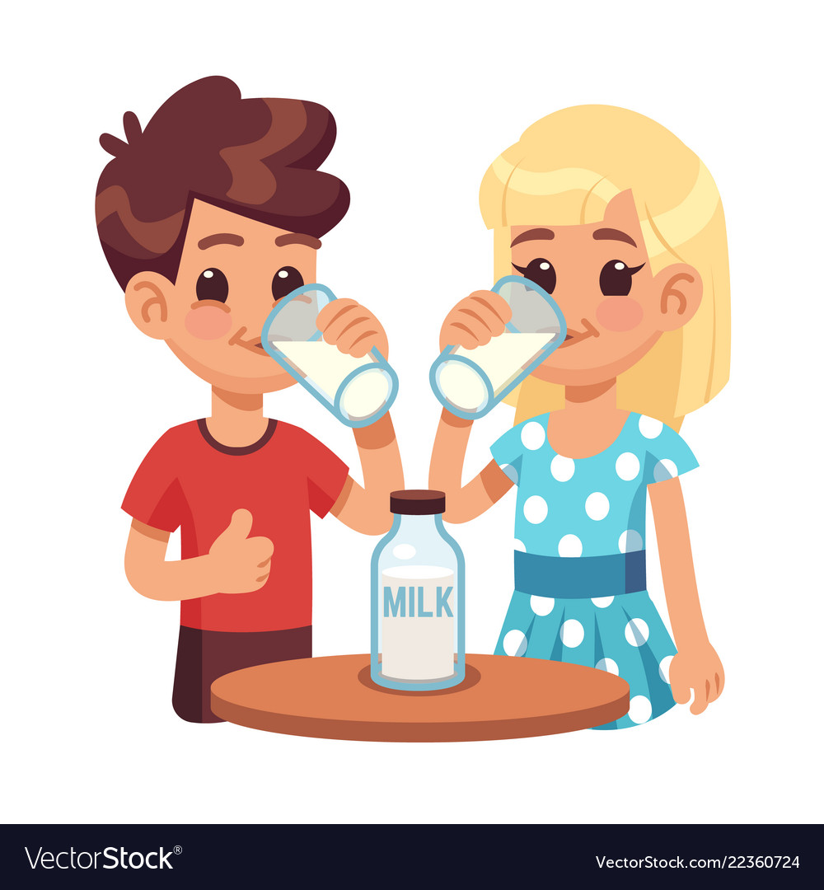
drink milk – пия мляко

Slide 13

listen to music – слушам музика

Slide 14
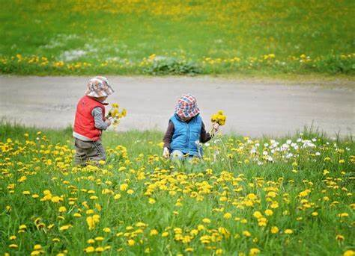
pick flowers – бера цветя

