Slide 1
English lesson 3rd grade
11.05.2020
Mrs. Dineva

Slide 2
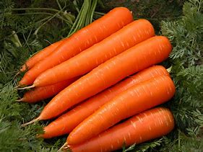
Are there…?
There are some carrots.

Slide 3
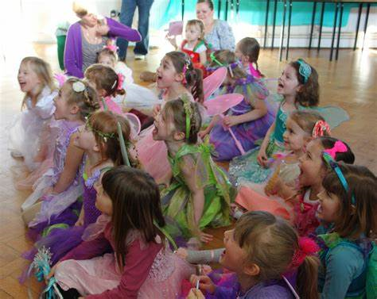
Are there…?
There are some children.

Slide 4
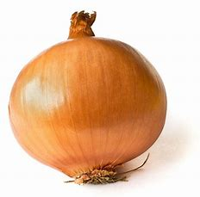
Is there…?
There is an onion.

Slide 5
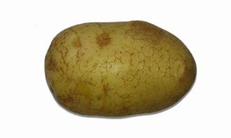
Is there…?
There is a potato

Slide 6
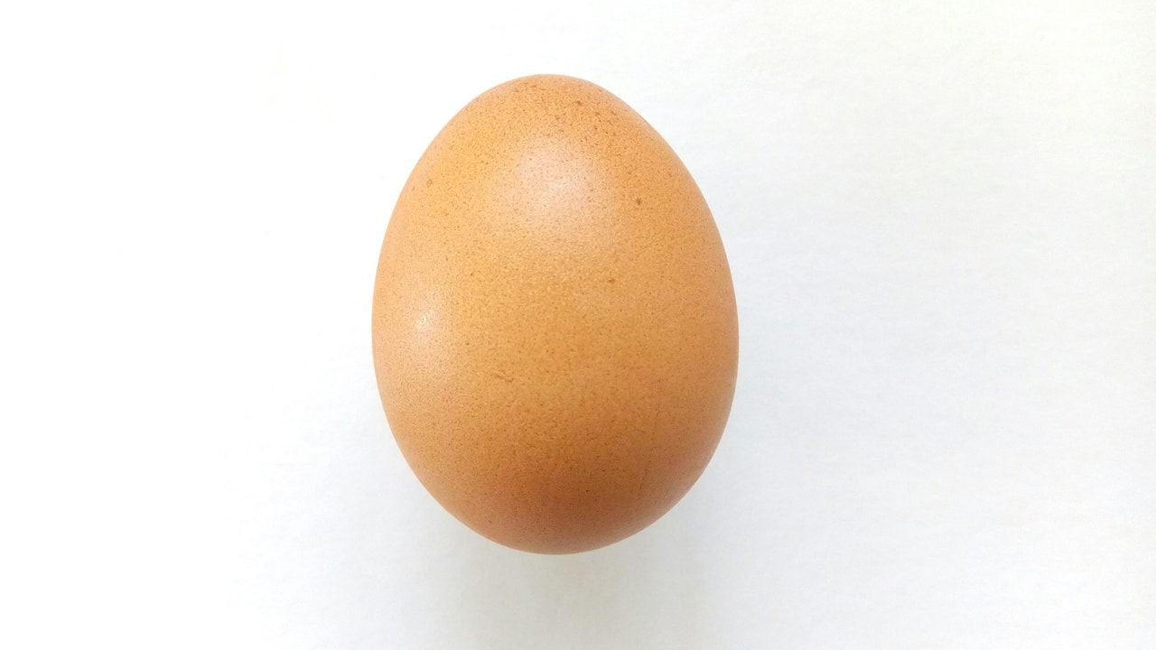
Is there…?
There is an egg.

Slide 7
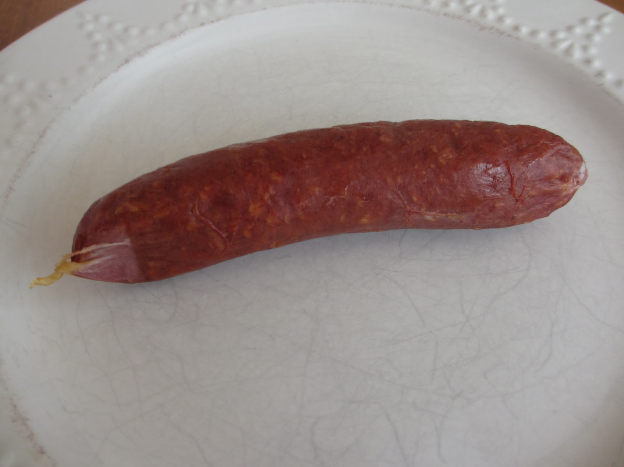
Is there…?
There is a sausage.

Slide 8
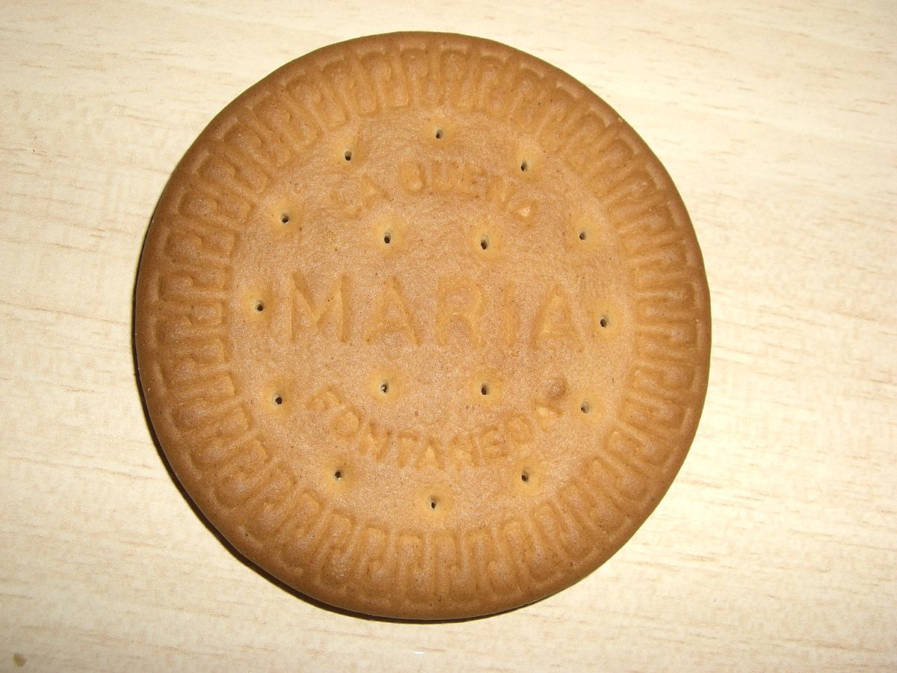
Is there…?
There is a biscuit.

Slide 9
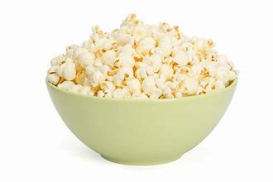
Is there…?
There is some popcorn

Slide 10
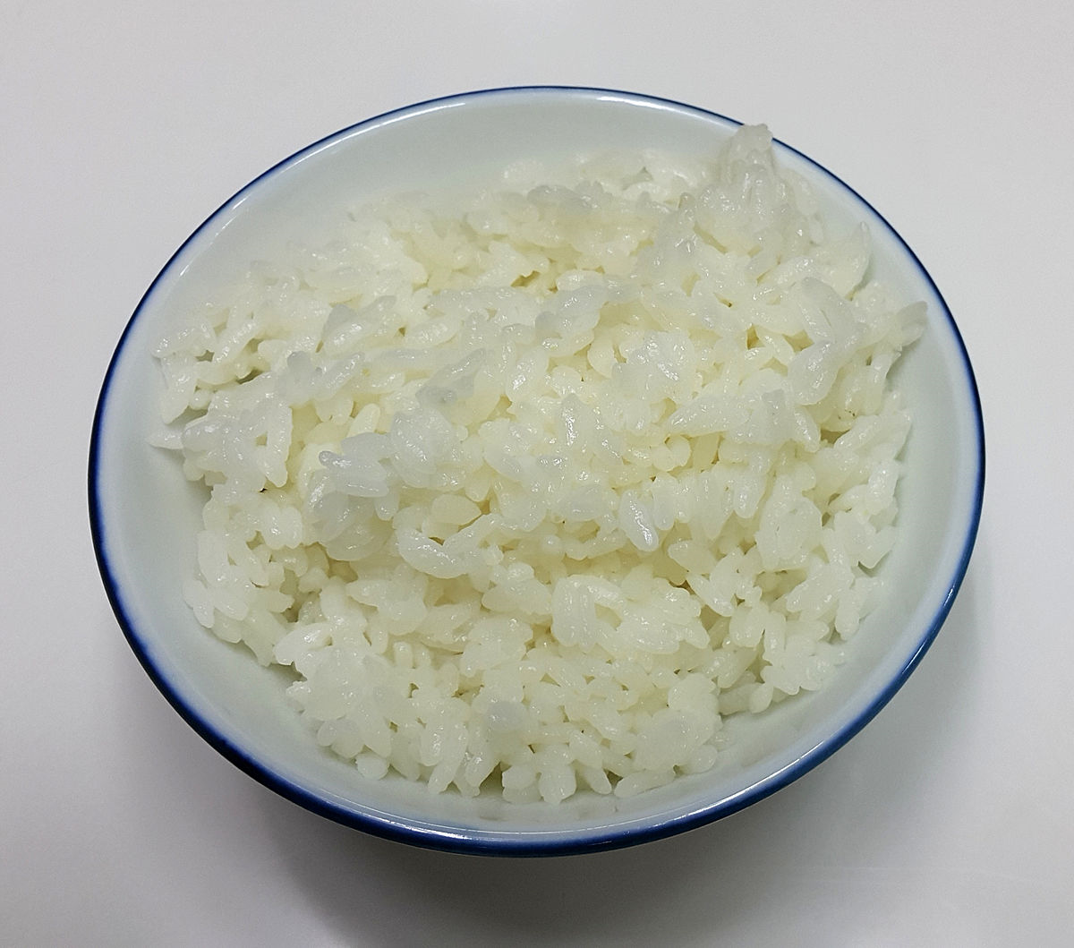
Is there…?
There is some rice

Slide 11
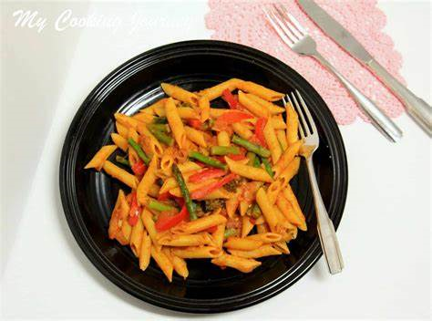
Is there…?
There is some pasta.

Slide 12
Some / Any
a carrot
an egg
some eggs,
some rice, pasta, popcorn, milk, juice
(+) There is some milk.
(?) Is there any rice?
(-) There isn’t any pasta.

Slide 13
Ex. 4/p. 75 Write a/an or some
1 a tomato
2 an onion
3 some milk
4 a potato
5 some rice
6 some pasta
7 a biscuit
8 some popcorn

Slide 14
Homework
Textbook /учебник/ - ex.5 - p. 75
Activity book /учебна тетрадка/ - ex.1, 2 – p. 62

