Slide 1
English lesson 3rd grade
12.05.2020
Mrs. Dineva

Slide 2
Ex. 5/p.75 Read and write
1. There are some / any sausages.
2. Is there some / any rice ?
3. Are there some / any carrots ?
4. There isn’t some / any orange juice.
5. There aren’t some / any biscuits.
6. There is some / any pasta.

Slide 3
Ex. 3/p. 63 Write a/an/some
1. a biscuit
2. an egg
3. some popcorn
4. some rice
5. an onion
6. some milk
7. a potato
8. some pasta

Slide 4
Ex.4/p. 63 Look and complete
1. There is some pasta.
2. There isn’t any rice.
3. There aren’t any biscuits.
4. There are some sausages.
5. There aren’t any potatoes.
6. There aren’t any onions.
7. There is some milk.
8. There is some orange juice.

Slide 5
Ex. 5/p. 63 Make questions
1. Is there any rice?
Yes, there is.
2. Are there any biscuits?
No, there aren’t any biscuits.
3. Are there any eggs?
No, there aren’t any eggs.
4. Are there any sausages?
Yes, there are some sausages.
5. Is there any popcorn?
No, there isn’t any popcorn.
6. Is there any milk?
Yes, there is some milk.

Slide 6
Our world
apple pie - ябълков пай
spring rolls – пролетни рулца

Slide 7
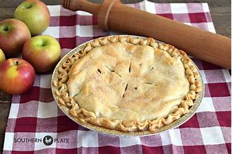
Our world
apple pie - ябълков пай

Slide 8
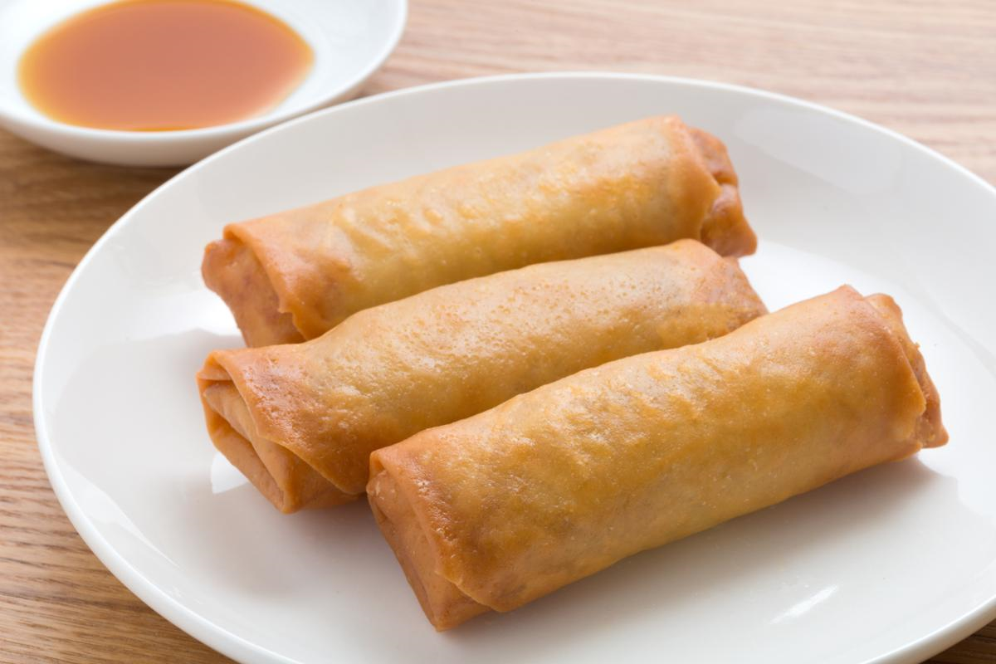
Our world
spring rolls – пролетни рулца

Slide 9

Homework
Activity book – ex.2 / p. 64
ex.1 / p. 65
Our world - урокът на четене
New words /новите думи/

