Slide 1
English lesson 3rd grade
21.04.2020
Mrs. Dineva

Slide 2
Present continuous
Positive | Negative | Question | Short answers
We are (’re) eating. | We are not (aren’t) eating. | Are we eating? | Yes, we are. No, we aren’t.
You are (’re) eating. | You are not (aren’t) eating. | Are you eating? | Yes, we are. No, we aren’t.
They are (’re) eating. | They are not (aren’t) eating. | Are they eating? | Yes, they are. No, they aren’t.

Slide 3
Classwork
Ex.1 Present continuous:
1. We (read) ……………... books.
2. ………………. they / sing?
Yes,……………….
3. ………………you / run?
No, ……………..

Slide 4
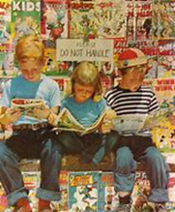
Classwork
Ex.1 Present continuous:
1. We are reading books.
2. ………………. they / sing?
Yes,……………….
3. ………………you / run?
No, ……………..

Slide 5
Classwork
Ex.1 Present continuous:
1. We are reading books.
2. Are they singing ?
Yes,……………….
3. ………………you / run?
No, ……………..

Slide 6
Classwork
Ex.1 Present continuous:
1. We are reading books.
2. Are they singing ?
Yes, they are.
3. ………………you / run?
No, ……………..

Slide 7
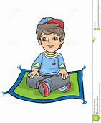
Classwork
Ex.1 Present continuous:
1. We are reading books.
2. Are they singing ?
Yes, they are.
3. Are you running ?
No, ……………..

Slide 8
Classwork
Ex.1 Present continuous:
1. We are reading books.
2. Are they singing ?
Yes, they are.
3. Are you running ?
No, I am not.

Slide 9
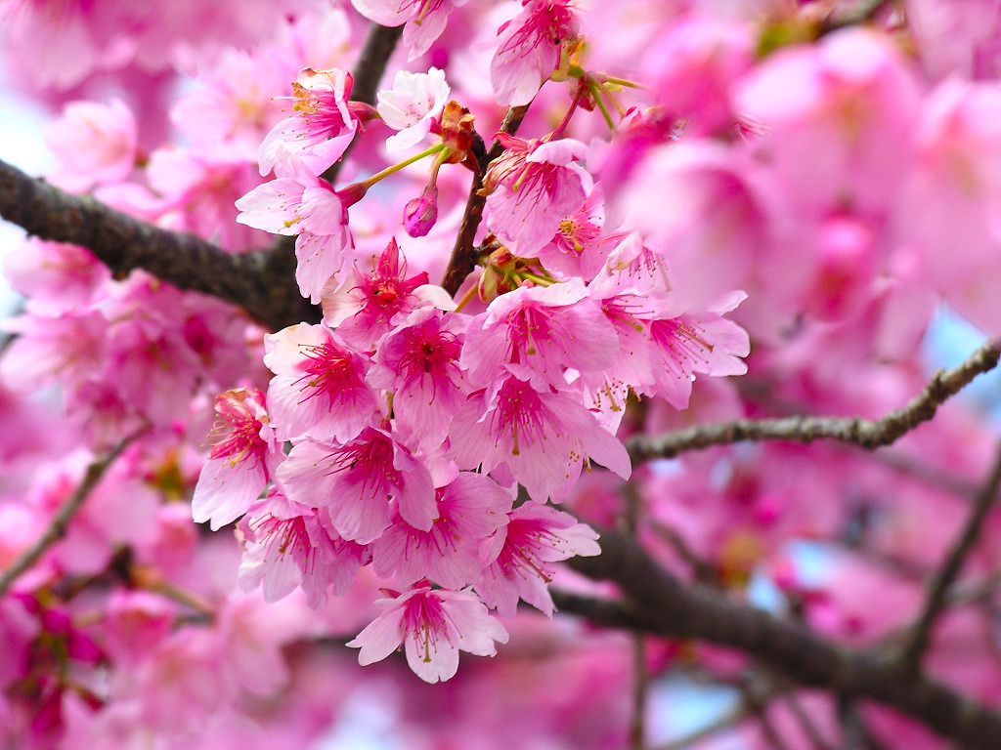
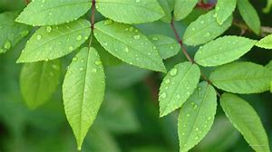
A tree for all seasons!
blossom – цвят, цъфтя
leaves - листа
full – изпълнен
empty - празен

Slide 10
A tree for all seasons!
1. Spring

Slide 11
A tree for all seasons!
2. Summer

Slide 12
A tree for all seasons!
3. Autumn

Slide 13
A tree for all seasons!
4. Winter

Slide 14
A tree for all seasons!
Ex. 3/p. 67
1. Spring
2. Summer
3. Autumn
4. Winter

Slide 15
