Slide 1
English lesson 3rd grade
22.04.2020
Mrs. Dineva

Slide 2
Pennies from the sky
poor - беден
kind - мил
sky - небе
pennies - пенита

Slide 3
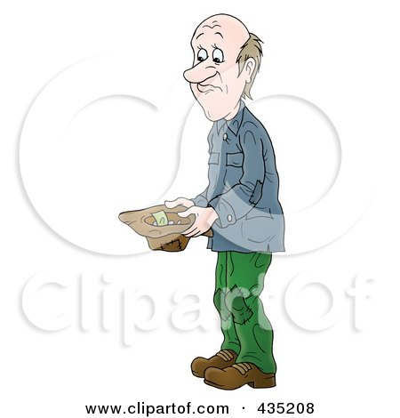
Pennies from the sky
poor - беден

Slide 4

Pennies from the sky
kind - мил

Slide 5
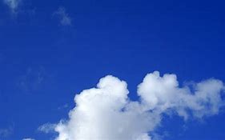
Pennies from the sky
sky - небе

Slide 6
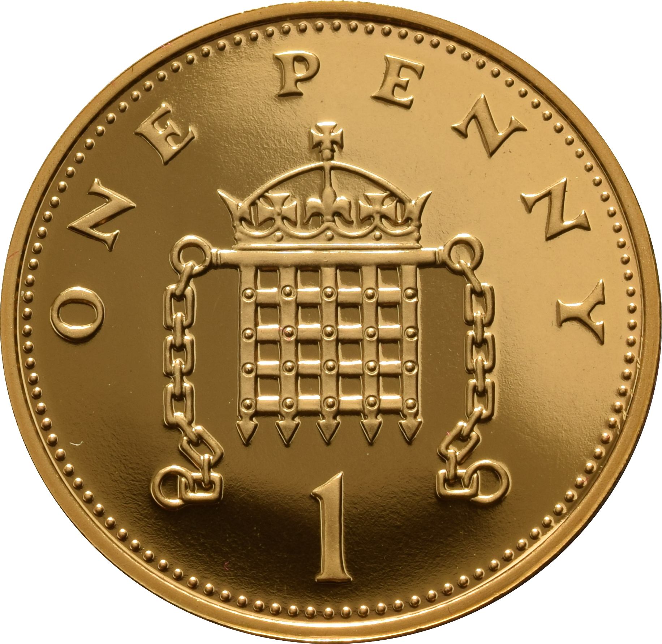
Pennies from the sky
pennies - пенита

Slide 7
Homework
Pennies from the sky
New words
Ex. 2/p.69

