Slide 1
English lesson 3rd grade
23.03.2020

Slide 2
Present continuous tense
Сегашно продължително време
I am (I’m) playing.
You are (You’re) playing.
He is (He’s) playing.
She is (She’s) playing.
It is (It’s) playing.
We are (We’re) playing.
They are ( They’re) playing.
! make – making
! ride –riding
! sit – sitting
! run - running

Slide 3
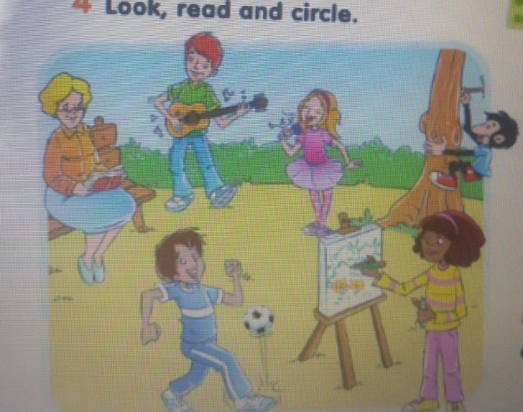
Ex. 4/p. Look, read and write.
Nanny Rose is reading / wlaking.
Liam is jumping / playing the guitar.
Lilly is making a snowman/singing.
Charlie is climbing / flying.
Jake is cooking / playing football.
Daisy is drawing / riding a horse.

Slide 4
Ex. 4/p. Look, read and write.
Nanny Rose is reading / wlaking.
Liam is playing the guitar.
Lilly is making a snowman/singing.
Charlie is climbing / flying.
Jake is cooking / playing football.
Daisy is drawing / riding a horse.

Slide 5
Ex. 4/p. Look, read and write.
Nanny Rose is reading / wlaking.
Liam playing the guitar.
Lilly is singing.
Charlie is climbing / flying.
Jake is cooking / playing football.
Daisy is drawing / riding a horse.

Slide 6
Ex. 4/p. Look, read and write.
Nanny Rose is reading / wlaking.
Liam playing the guitar.
Lilly is singing.
Charlie is climbing.
Jake is cooking / playing football.
Daisy is drawing / riding a horse.

Slide 7
Ex. 4/p. Look, read and write.
Nanny Rose is reading / wlaking.
Liam playing the guitar.
Lilly is singing.
Charlie is climbing.
Jake is playing football.
Daisy is drawing / riding a horse.

Slide 8
Ex. 4/p. Look, read and write.
Nanny Rose is reading / wlaking.
Liam is playing the guitar.
Lilly is singing.
Charlie is climbing.
Jake is playing football.
Daisy is drawing.

Slide 9

What is he doing?

Slide 10
What is he doing?
He is reading a book.

Slide 11

What is she doing?

Slide 12
What is she doing?
She is singing.

Slide 13
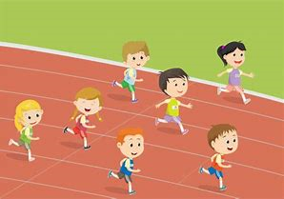
What are they doing?

Slide 14
What are they doing?
They are running.
! run - running

Slide 15
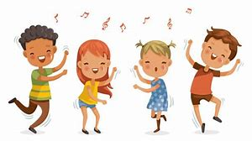
What are we doing?

Slide 16
What are we doing?
We are dancing.
! dance - dancing

Slide 17

What are you doing?
I

Slide 18

Let’s sing
https://www.youtube.com/watch?v=MiZxlVi_RSg&fbclid=IwAR3ofB6rvq4NatE4DGqLNWzwMUbpTHqtLBrOOQ3cIiCvLrohiYuyvXF8Lro

Slide 19
Homework
Activity book – ex. 3 / p. 47
ex. 4 /p. 47

