Slide 1
English lesson 3rd grade
24.03.2020
Mrs. Dineva

Slide 2
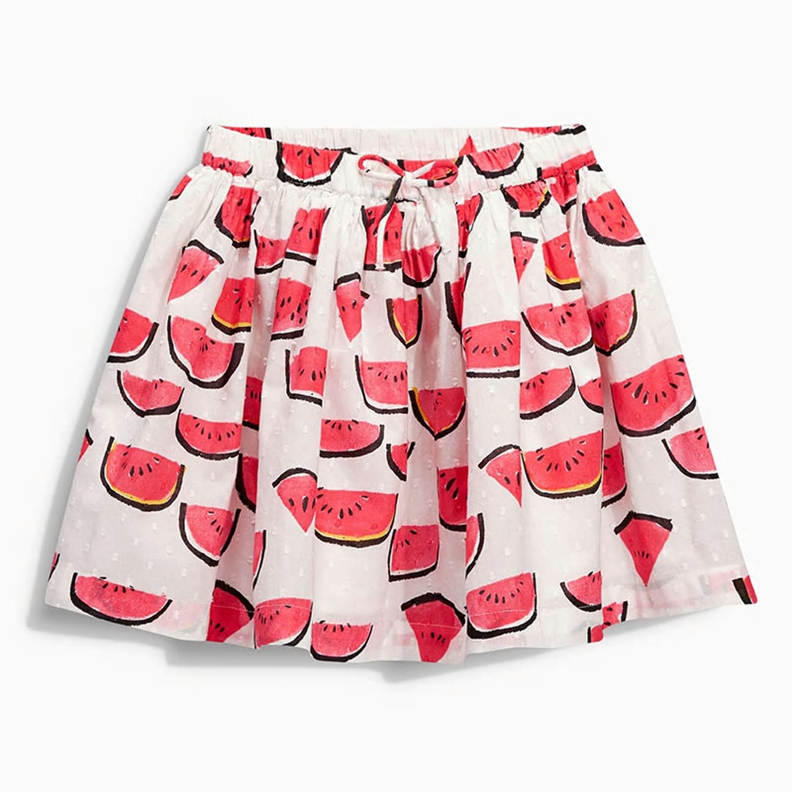
I am wearing
skirt – пола

Slide 3
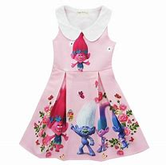
I am wearing
dress - рокля

Slide 4
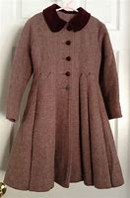
I am wearing
coat - палто

Slide 5
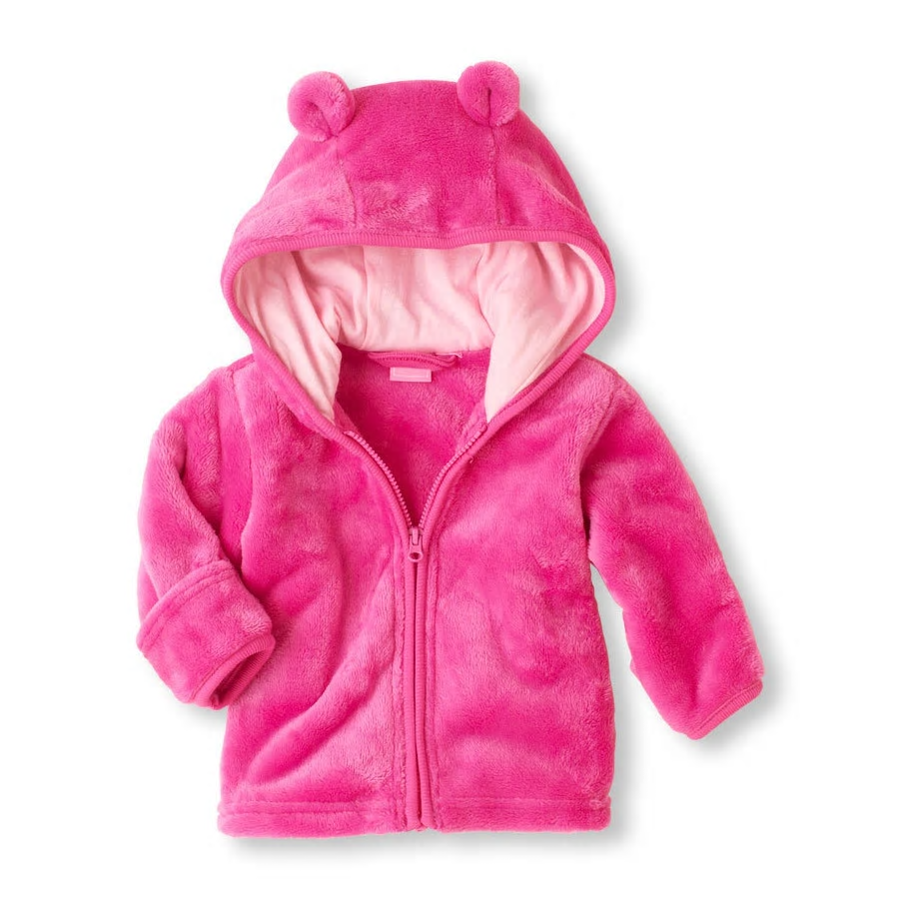
I am wearing
jacket - яке

Slide 6
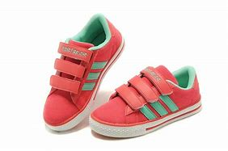
I am wearing
shoes - обувки

Slide 7
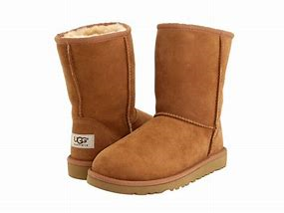
I am wearing
boots - ботуши

Slide 8
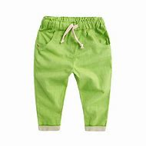
I am wearing
trousers - панталони

Slide 9
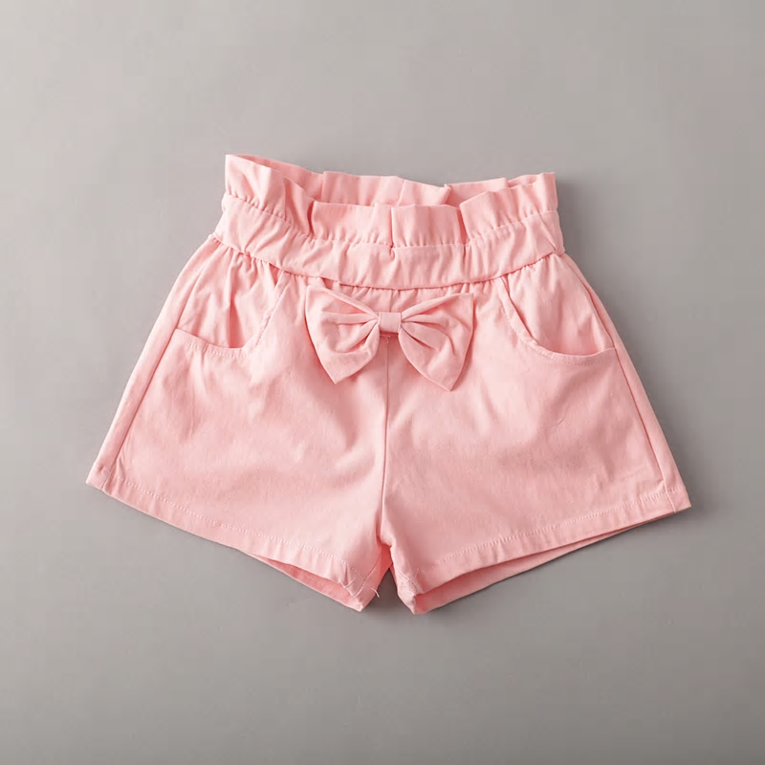
I am wearing
shorts – къси панталонки

Slide 10

I am wearing
T-shirt - тениска

Slide 11
I am wearing….
skirt – пола
dress - рокля
coat - палто
jacket - яке
shoes - обувки
boots - ботуши
trousers - панталони
shorts – къси панталонки
T-shirt - тениска

Slide 12
Ex. 1/p. 58
1. shorts
2. T-shirt
3. dress
4. trousers
5. shoes

Slide 13
I am wearing
Еexercise https://quizlet.com/_88mslm?x=1qqt&i=2niv5g
Test https://quizlet.com/498229834/test

