Slide 1
English lesson 3rd grade
25.03.2020
Mrs. Dineva

Slide 2
I am wearing
Ex. 4/p. 59 Complete. Use: wear, play, jump, sing, paint, climb
We are wearing our coats.
You …………….. a nice song.
They ……………. that tree.
We …………….. football.
They ……………. up and down.
You ……………… a lovely picture.

Slide 3
I am wearing
Ex. 4/p. 59 Complete. Use: wear, play, jump, sing, paint, climb
We are wearing our coats.
You are singing a nice song.
They ……………. that tree.
We …………….. football.
They ……………. up and down.
You ……………… a lovely picture.

Slide 4
I am wearing
Ex. 4/p. 59 Complete. Use: wear, play, jump, sing, paint, climb
We are wearing our coats.
You are singing a nice song.
They are climbing that tree.
We …………….. football.
They ……………. up and down.
You ……………… a lovely picture.

Slide 5
I am wearing
Ex. 4/p. 59 Complete. Use: wear, play, jump, sing, paint, climb
We are wearing our coats.
You are singing a nice song.
They are climbing that tree.
We are playing football.
They ……………. up and down.
You ……………… a lovely picture.

Slide 6
I am wearing
Ex. 4/p. 59 Complete. Use: wear, play, jump, sing, paint, climb
We are wearing our coats.
You are singing a nice song.
They are climbing that tree.
We are playing football.
They are jumping up and down.
You ……………… a lovely picture.

Slide 7
I am wearing
Ex. 4/p. 59 Complete. Use: wear, play, jump, sing, paint, climb
We are wearing our coats.
You are singing a nice song.
They are climbing that tree.
We are playing football.
They are jumping up and down.
You are painting a lovely picture.

Slide 8
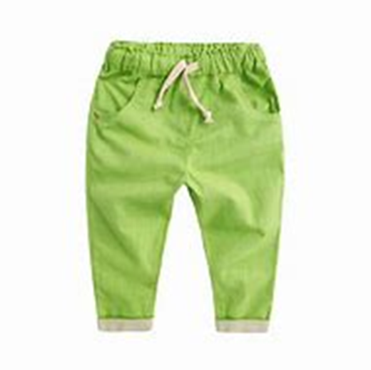
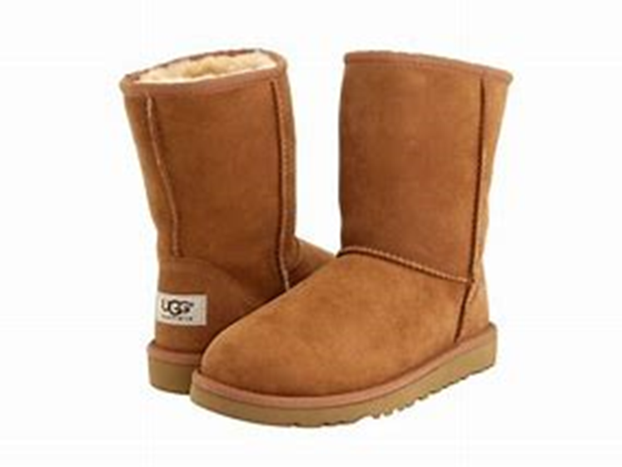
What is Tim wearing?

Slide 9
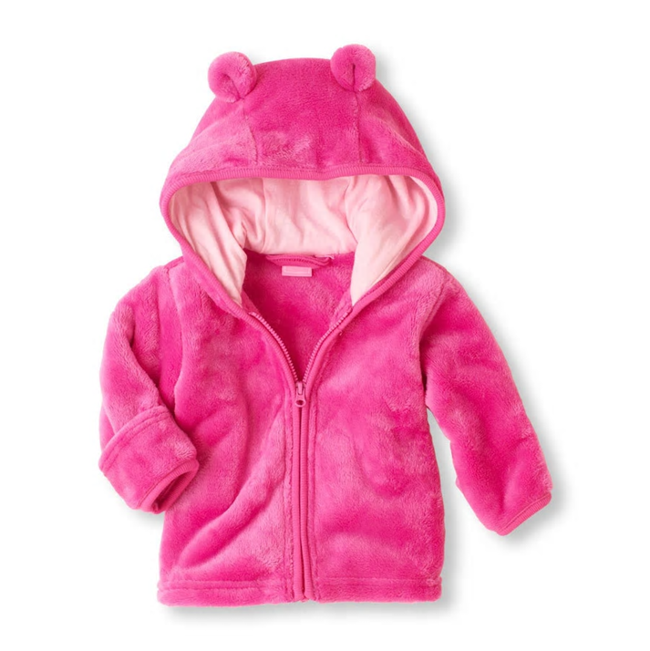
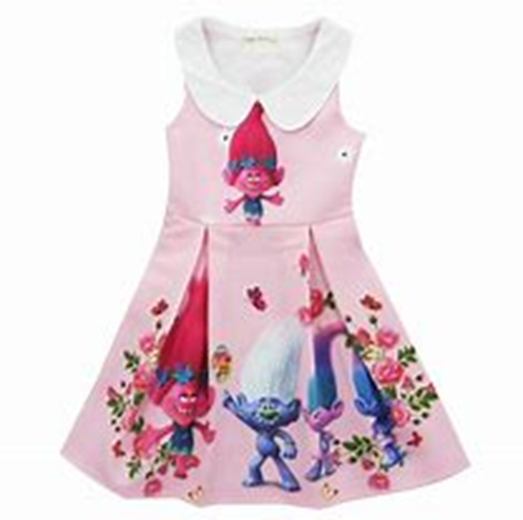
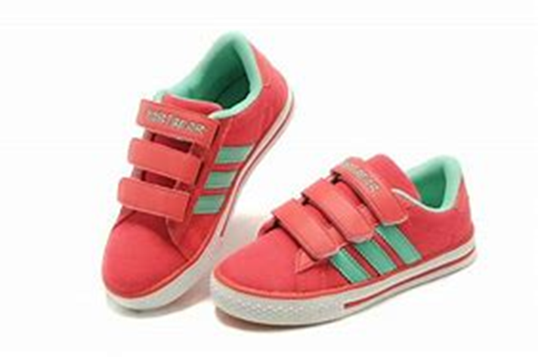
What is Amy wearing?

Slide 10
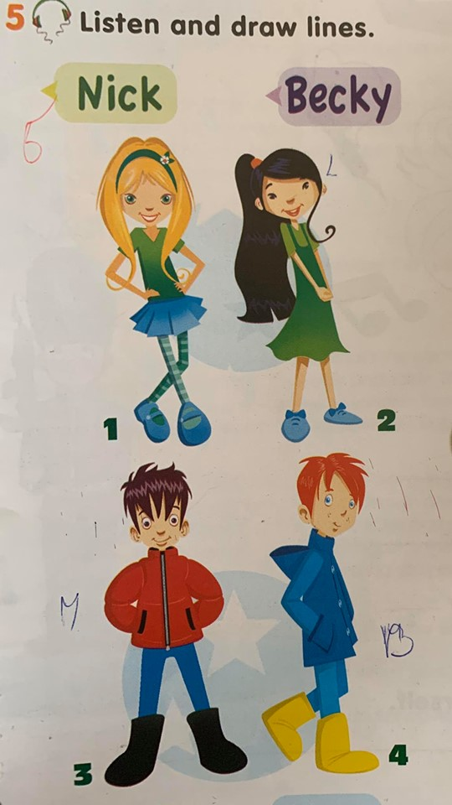
Ex. 5/p 59 Listen and write
Listen and write: Nick, Becky, Lisa, Max
1
2
3
4

Slide 11
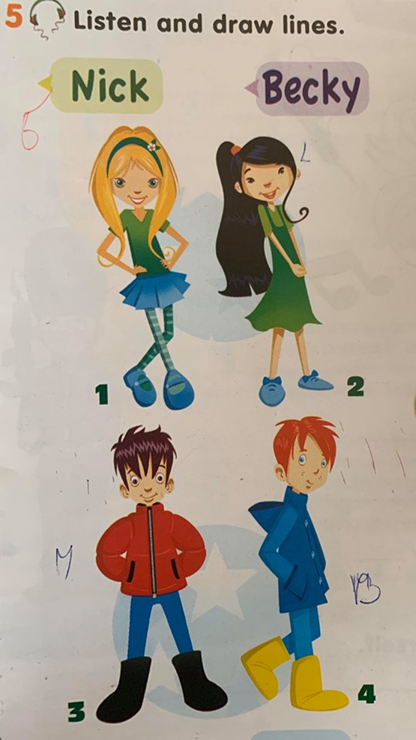
Ex. 5/p 59 Listen and write
Listen and write: Nick, Becky, Lisa, Max
1 Becky
2
3
4

Slide 12
Ex. 5/p 59 Listen and write
Listen and write: Nick, Becky, Lisa, Max
1 Becky
2 Lisa
3
4

Slide 13
Ex. 5/p 59 Listen and write
Listen and write: Nick, Becky, Lisa, Max
1 Becky
2 Lisa
3 Nick
4 Max

Slide 14
Homework

