Slide 1
English lesson 3rd grade
27.04.2020
Mrs. Dineva

Slide 2
Pennies from the sky
poor - беден
kind - мил
sky - небе
pennies - пенита

Slide 3
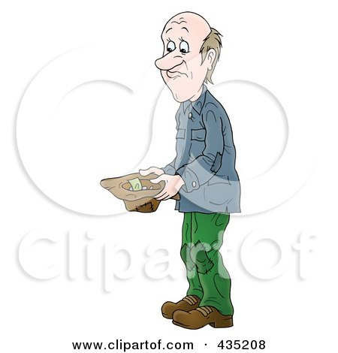
Pennies from the sky
poor - беден

Slide 4

Pennies from the sky
kind - мил

Slide 5

Pennies from the sky
sky - небе

Slide 6

Pennies from the sky
pennies - пенита

Slide 7
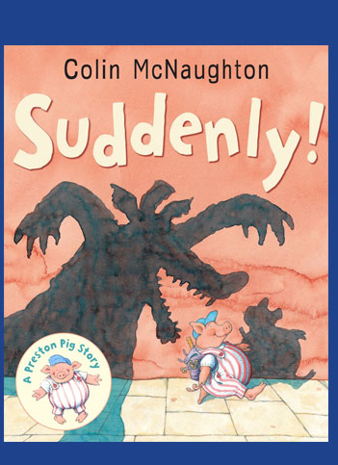
Pennies from the sky
suddenly - изведнъж

Slide 8
Ex.2 /p 69 Which picture? Read the story and write.
1.My little girl hasn’t got shoes.
2.It’s raining and I’m not wearing a hat.
3.It’s raining and I’m not wearing a dress.
4.Take my dress.
5.Pennies from the sky!
6.I’m not cold.
Picture ……
Picture ……
Picture ……
Picture ……
Picture ……
Picture ……

Slide 9
Ex.2 /p 69 Which picture? Read the story and write.
1.My little girl hasn’t got shoes.
2.It’s raining and I’m not wearing a hat.
3.It’s raining and I’m not wearing a dress.
4.Take my dress.
5.Pennies from the sky!
6.I’m not cold.
Picture 2
Picture ……
Picture ……
Picture ……
Picture ……
Picture ……

Slide 10
Ex.2 /p 69 Which picture? Read the story and write.
1.My little girl hasn’t got shoes.
2.It’s raining and I’m not wearing a hat.
3.It’s raining and I’m not wearing a dress.
4.Take my dress.
5.Pennies from the sky!
6.I’m not cold.
Picture 2
Picture 4
Picture ……
Picture ……
Picture ……
Picture ……

Slide 11
Ex.2 /p 69 Which picture? Read the story and write.
1.My little girl hasn’t got shoes.
2.It’s raining and I’m not wearing a hat.
3.It’s raining and I’m not wearing a dress.
4.Take my dress.
5.Pennies from the sky!
6.I’m not cold.
Picture 2
Picture 4
Picture 6
Picture ……
Picture ……
Picture ……

Slide 12
Ex.2 /p 69 Which picture? Read the story and write.
1.My little girl hasn’t got shoes.
2.It’s raining and I’m not wearing a hat.
3.It’s raining and I’m not wearing a dress.
4.Take my dress.
5.Pennies from the sky!
6.I’m not cold.
Picture 2
Picture 4
Picture 6
Picture 7
Picture ……
Picture ……

Slide 13
Ex.2 /p 69 Which picture? Read the story and write.
1.My little girl hasn’t got shoes.
2.It’s raining and I’m not wearing a hat.
3.It’s raining and I’m not wearing a dress.
4.Take my dress.
5.Pennies from the sky!
6.I’m not cold.
Picture 2
Picture 4
Picture 6
Picture 7
Picture 9
Picture ……

Slide 14
Ex.2 /p 69 Which picture? Read the story and write.
1.My little girl hasn’t got shoes.
2.It’s raining and I’m not wearing a hat.
3.It’s raining and I’m not wearing a dress.
4.Take my dress.
5.Pennies from the sky!
6.I’m not cold.
Picture 2
Picture 4
Picture 6
Picture 7
Picture 9
Picture 10

