Slide 1
English lesson 3rd grade
31.03.2020
Mrs. Dineva

Slide 2
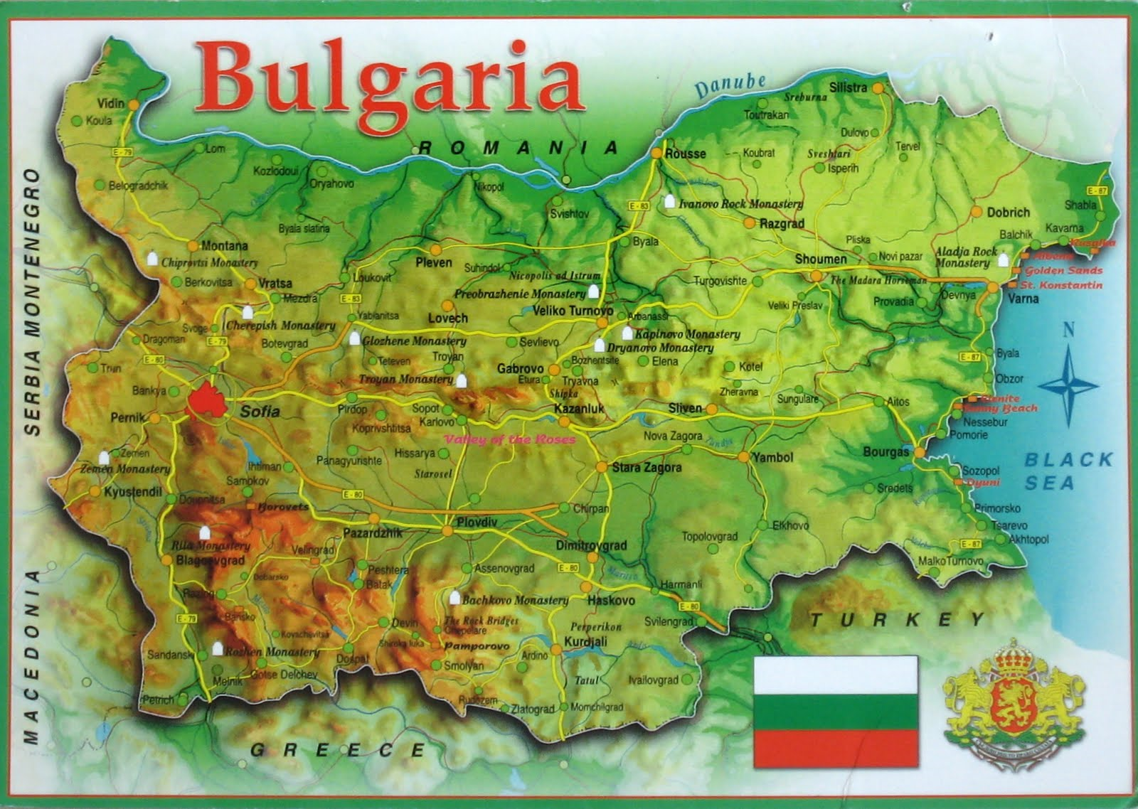
Bulgaria - Sofia

Slide 4
England - London

Slide 5
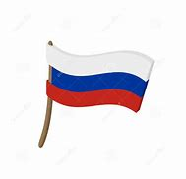
Russia - Moscow

Slide 6
Argentina – Buenos Aires

Slide 7
Our world
Ex. 4 / p. 61 Listen and read

Slide 8
Our world
Russia - Русия
Argentina – Аржентина
raincoat - дъждобран

Slide 9
Ex. 5 Read and complete
1. In London it’s …………………….. today.
2. In Buenos Aires it’s ………………… today.
3. In Moscow it’s ……………….. today.
4. Lucas and Matias are wearing their white ……………….. .
5. Olga and her friends are wearing their ………………… and ……………… .

Slide 10
Ex. 5 Read and complete
1. In London it’s raining today.
2. In Buenos Aires it’s ………………… today.
3. In Moscow it’s ……………….. today.
4. Lucas and Matias are wearing their white ……………….. .
5. Olga and her friends are wearing their ………………… and ……………… .

Slide 11
Ex. 5 Read and complete
1. In London it’s raining today.
2. In Buenos Aires it’s sunny today.
3. In Moscow it’s ……………….. today.
4. Lucas and Matias are wearing their white ……………….. .
5. Olga and her friends are wearing their ………………… and ……………… .

Slide 12
Ex. 5 Read and complete
1. In London it’s raining today.
2. In Buenos Aires it’s sunny today.
3. In Moscow it’s snowing today.
4. Lucas and Matias are wearing their white ……………….. .
5. Olga and her friends are wearing their ………………… and ……………… .

Slide 13
Ex. 5 Read and complete
1. In London it’s raining today.
2. In Buenos Aires it’s sunny today.
3. In Moscow it’s snowing today.
4. Lucas and Matias are wearing their white T-shirt .
5. Olga and her friends are wearing their ………………… and ……………… .

Slide 14
Ex. 5/p. 61 Read and complete
1. In London it’s raining today.
2. In Buenos Aires it’s sunny today.
3. In Moscow it’s snowing today.
4. Lucas and Matias are wearing their white T-shirt .
5. Olga and her friends are wearing their hats and jackets.

Slide 15
Homework
Activity book
Ex. 2 /p.50
Ex. 1 / p.51
Words /упражнение на новите думи/

