Slide 1
A country is one of the best tourist destination. Famous for it historic buildings and places for mane Hollywood and European movies
Where are you?

Slide 2
The Czech Republic
through my eyes
Next step of social life learning through English

Slide 3
The Czech Republic is bordered by Germany to its north and west, Poland to its northeast, Slovakia to its east and Austria to its south.

Slide 4
The meaning of the colors of the Czech Republic flag is: - White - peace, red - strength and blue - truth, loyalty and determined and fair people.

Slide 5
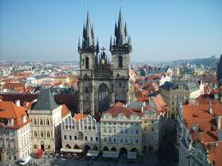
Prague is the capital and largest city of the Czech Republic. It is the 15th largest city in the European Union. It is also the historical capital of Bohemia.

Slide 6
Prague. Situated in the north-west of the country on the Vltava river, the city is home to about 1.26 million people, while its larger urban zone is estimated to have a population of nearly 2 million

Slide 7
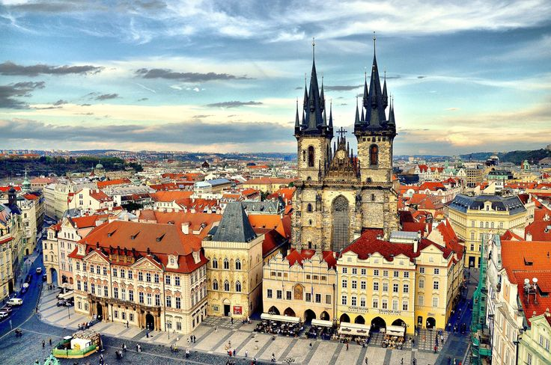
Prague Castle
According to the Guinness Book of Records, Prague Castle is the largest ancient castle in the world, occupying an area of almost 70,000 m, at about 570 meters in length and an average of about 130 meters wide

Slide 8
Education
90% of Czechs have completed at least secondary education - the highest score in the EU
Zakladni skola a Materska skola Olomouc, Gorkeho 39

Slide 9
Sport
The two leading sports in the Czech Republic are football and ice hockey, both drawing the largest attention of both the media and supporters. The many other sports with professional leagues and structures include basketball, volleyball, team handball, Czech handball, athletics, floorball and others

Slide 10
Knedlíky
Dumplings (knedlíky) (steamed and sliced bread-like) are one of the mainstays of Czech food and are typically served with meals. They can be either wheat or potato-based, and are sometimes made from a combination of wheat flour and dices made of stale bread or rolls.

Slide 11
Czech folklore
Nowadays it is preserved and kept alive by various folklore ensembles uniting members of all ages, from children to seniors, showing their talent during competitions, folklore festivals or other performances

Slide 12
Learn more from
Next step of social life learning through English

