Slide 1
HAPPY EASTER!
“NEXT STEP OF SOCIAL LIFE LEARNING THROUGH ENGLISH”

Slide 3
EASTER IN EUROPE

Slide 4
WISH YOU..

Slide 6
EASTER IN THE CHECH REPUBLIC

Slide 7
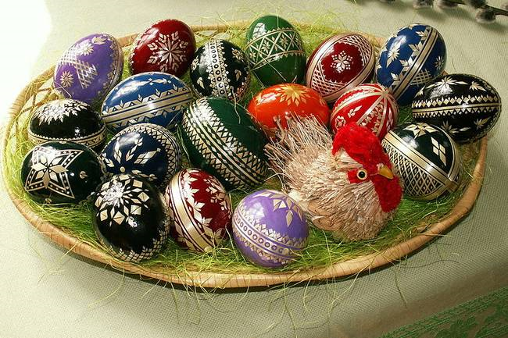

Slide 9
EASTER IN LITHUANIA

Slide 12
EASTER IN SPAIN

Slide 15
EASTER IN BULGARIA

