Slide 1
Imagine taking a hot air balloon ride over a big city. You can see for miles and notice new, tall buildings in the distance as you float over old buildings and green space with a lot of trees. You also see a river with several bridges crossing it as you glide by. You are drifting over the capital city of …….?
Where are you?

Slide 2

Lithuania through my eyes
Next step of social life learning through English

Slide 3
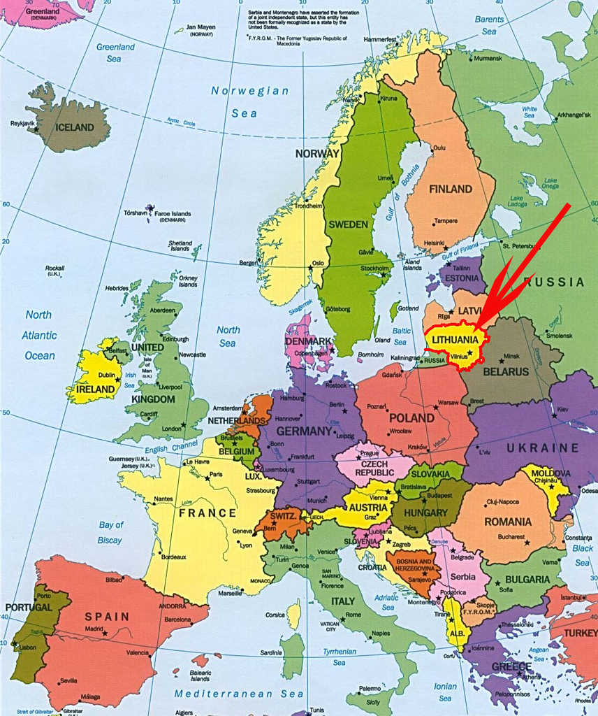
Lithuania is a small country on the Baltic Sea in northern Europe. It shares borders with Poland, Russia, Latvia, and Belarus.

Slide 4
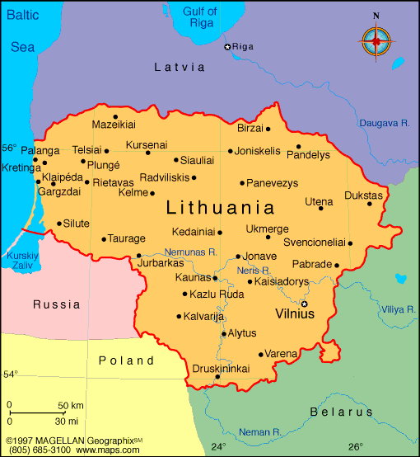
Lithuania was named the geographic middle of Europe in 1989. It is a little bigger than the state of West Virginia and has a lot of forests, hills, and plains.

Slide 5

Lithuanian flag
Yellow is for golden plain
Green for forest
Red for blood of heroes

Slide 6
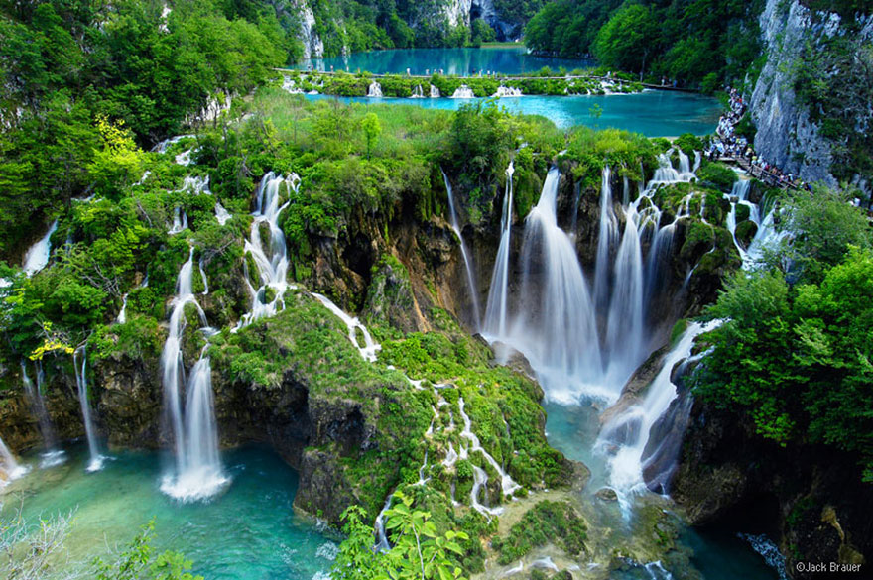
Lithuanian nature
Do you know that Lithuania has 758 rivers and over 2 800 lakes?
These environments
are important natural
habits and
many are nature reserves

Slide 7
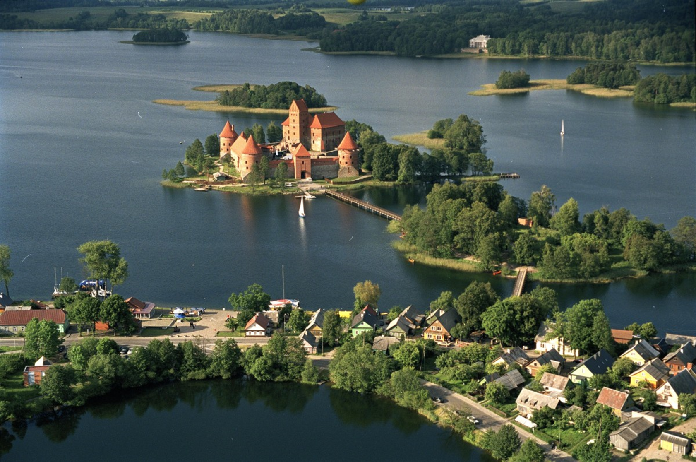
Trakai historical - national park

Slide 8
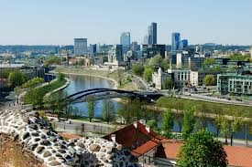
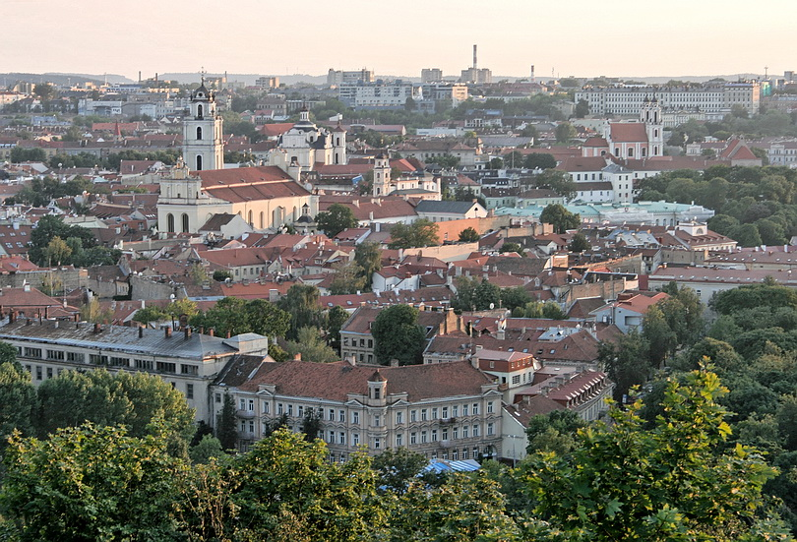
The capital city of Lithuania is Vilnius ,which is near the country's southeastern border. The Neris River runs through the city and has walking paths next to it so you can enjoy the water and even stop to fish!

Slide 9
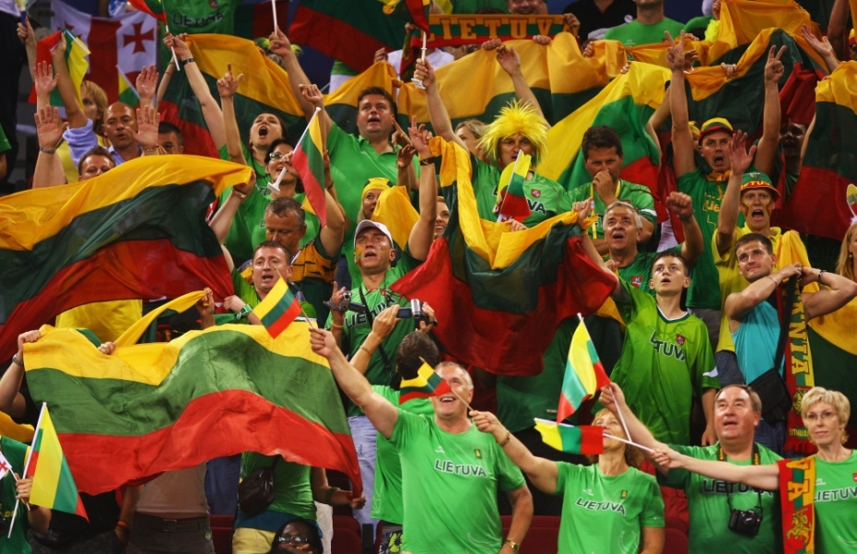
Sports
Lithuanians are great sport people.
The most popular sport is basketball.
Other popular sports are athletics,
Football, handball

Slide 10
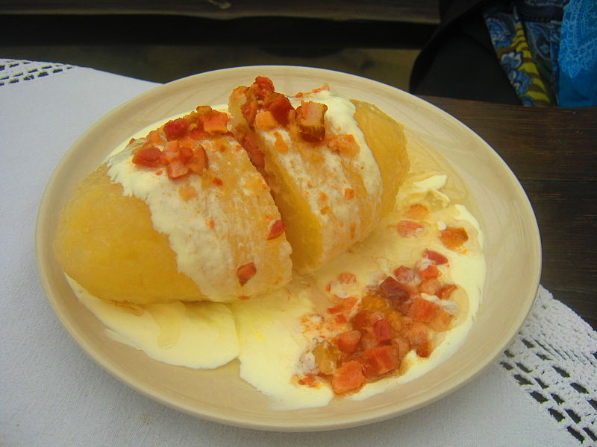
Food
Do you like sour cream?
Lithuanian food often includes sour cream, cottage cheese, meat and potatoes.
One popular tradition dish is Cepelinai – potato filled with meat and topped with sour cream and bacon.

Slide 11
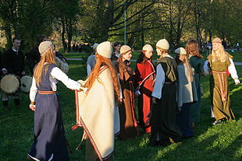
Music and dance
Lithuania is famous for its archaic folk songs, a UNESCO world heritage and a center-point of many Lithuanian cultural festivals and events.

Slide 12
If you want to know more..
Next step of social life learning through English

