Slide 1
It is a beautiful country located in southwestern Europe. The people and culture of Spain are unique and vivid. It's possible that your life has been influenced by Spain and you didn't even know.
You are in…..

Slide 2
Spain through my eyes
Next step of social life learning through English

Slide 3
Spain
Spain sits between the Mediterranean Sea and the Atlantic Ocean. Spain shares borders with Portugal and France

Slide 4
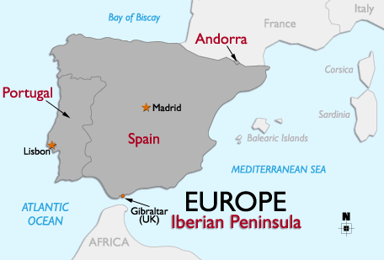
Spain is a country in a southern Europe and is part of the Iberian peninsula

Slide 5
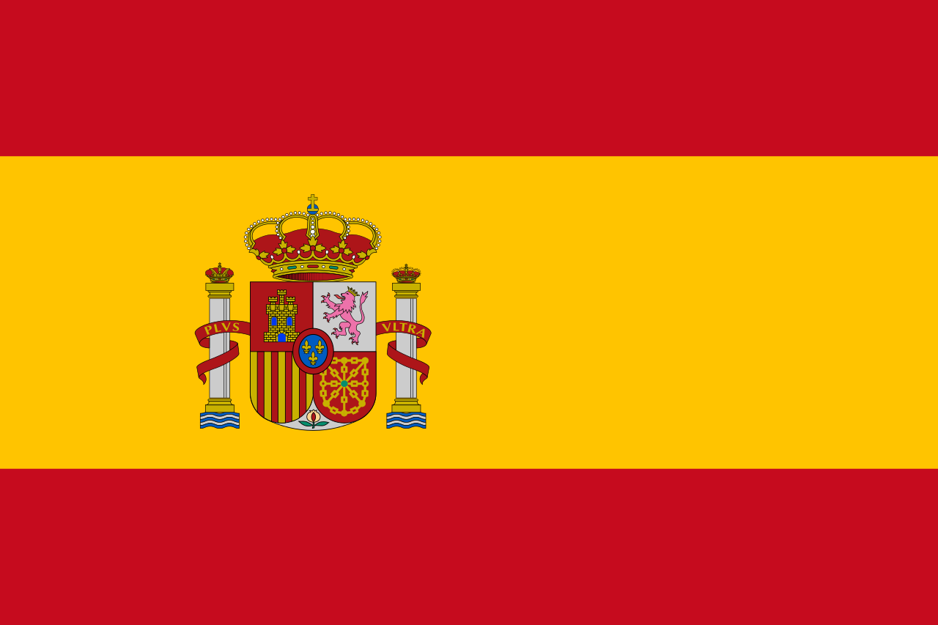
The red and yellow colors contained in the Spanish flag represent the colors of the original Spanish kingdoms. The Spanish flag also contains a coat of arms containing the Pillars of Hercules, which are meant to represent Gibraltar and Cueta.

Slide 6
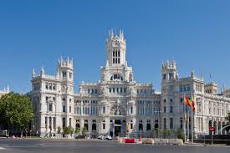
The capital is Madrid
The population of the city is almost 3.2 million. It is the third- largest in the European Union, after London and Berlin

Slide 7
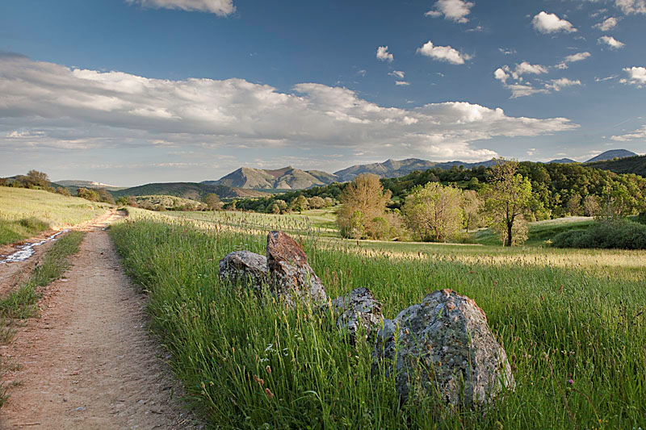
Within Spain, you can find mountains, valleys, lakes, rivers, deserts, farm land, vineyards, olive trees and forests, which shows the diversity of the climate.

Slide 8
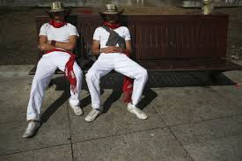
Siesta
Because Spain is so far west in the time zone, in the summer the sun may not go down until 10 pm! This is one of the reasons for the famous midday nap in Spain called a siesta. People go home to eat a light lunch and rest before returning to work in the afternoon.

Slide 9
Students
Children in Spain go to school from 9 am-12 pm, come home for a few hours, then go back to school from 3-5 pm. Spanish families eat dinner at around 9 pm.

Slide 10
Sports
Sport in Spain in the second half of the 20th century has always been dominated by football. Other popular sport activities include basketball, tennis, cycling, handball, motorcycling, Formula One, water sports, rhythmic gymnastics, golf, bullfighting and skiing

Slide 11
Bullflighting
Spanish-style bullflighting is called a corridae toros
In traditional corrida, three toreros, also called matadores or, each fight two out of a total of six fighting bulls, each of which is at least four years old and weighs up to about 600 kg

Slide 12
Food
A food called paella, which is a rice dish made with a spice called saffron

Slide 13
Flamenco music and dancing
Flamenco includes cante (singing), toque (guitar playing), baile (dance), jaleo (vocalizations), palmas (handclapping) and pitos (finger snapping).

Slide 14
Welcome to
Next step of social life learning through English

